Slide 1
Weather Analysis
Using numpy, pandas and metplotlib
Presented by:-
Arpit Soni & Arpit bhati
Topic:- Weather analysis

Slide 2
Problem Statement
Title: Understanding Weather Patterns Using Data Analysis
Challenge: Weather patterns fluctuate due to various factors like seasonality,
location, and environmental conditions.
Problem Statement:
Identifying trends in temperature, humidity, wind speed, and UV index.
Detecting outliers and cleaning data for better accuracy.
Understanding seasonal variations and their impact on weather conditions.

Slide 3
Goal & Summary
Title: Objectives & Key Insights
Goal: Analyze weather data efficiently using Python libraries (NumPy, Pandas, Matplotlib).
Present meaningful insights through visualizations.
Summary of Findings: Seasonal temperature distribution highlights significant variations.
The most common weather conditions in each season were identified.
Data cleaning (handling null values & outliers) improved analysis accuracy.
Seasonal trends in wind speed, UV index, and humidity were observed.

Slide 4
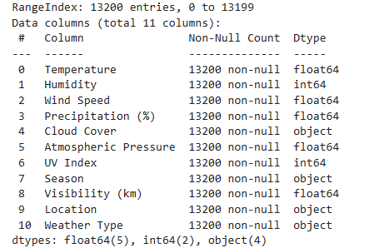
Columns and type
Provides an overview of all the dataset columns, explaining what each represents (e.g., temperature, wind speed, humidity). It also specifies the data types of each column (numerical, categorical, etc.), helping in understanding how the data is structured.

Slide 5
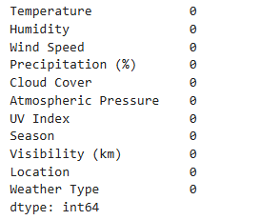
Null value
Highlights missing values in the dataset and discusses their impact on data analysis. It explains how missing values were handled, whether through imputation (mean/median/mode) or removal, ensuring the dataset remains accurate and reliable. Though we don’t have any.

Slide 6

Duplicate value
Discusses the presence of duplicate records in the dataset, which can lead to biased results. It describes how duplicate values were identified and removed to maintain data integrity, ensuring more accurate analysis.
The rows of duplicate value is zero.

Slide 7
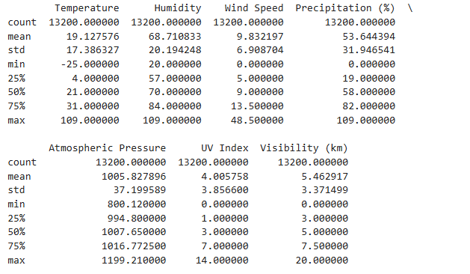
Summary before adjusting outlier
Presents the initial statistical summary of the dataset before handling outliers. This includes measures such as mean, median, and standard deviation, highlighting potential anomalies that could impact the results.

Slide 8
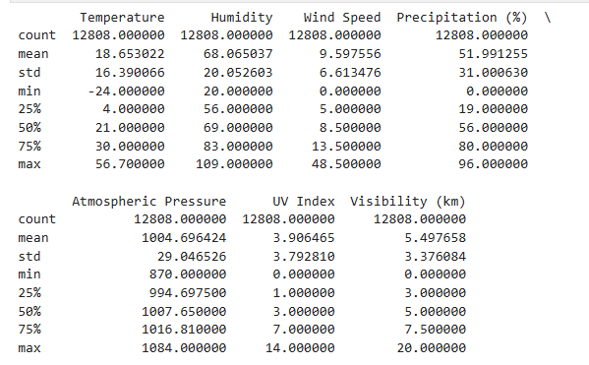
After adjusting outliers
Compares the dataset before and after handling outliers. Explains the methods used to detect and treat outliers (e.g., IQR method, Z-score), showing how removing extreme values improved the reliability of the dataset.

Slide 9
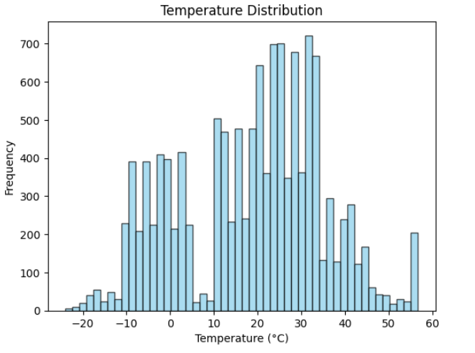
Temperature frequency
Visualizes how frequently different temperature ranges occur in the dataset. Helps in understanding the general distribution of temperature values, identifying whether the dataset follows a normal distribution or has any skewness.

Slide 10
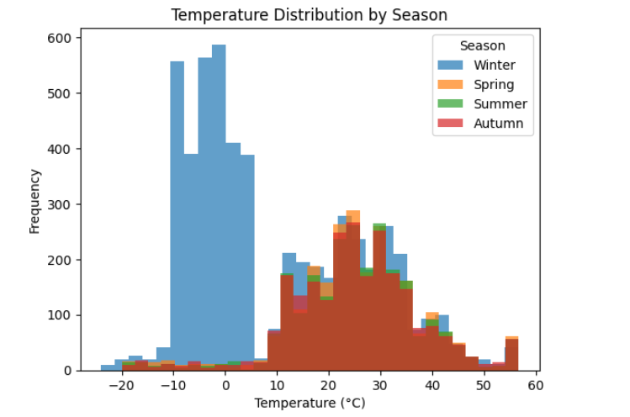
Season wise temperature frequency
Breaks down temperature variations across different seasons. This slide helps in identifying patterns such as extreme temperatures in summer/winter and mild temperatures in spring/autumn, providing insights into seasonal climate trends.

Slide 11
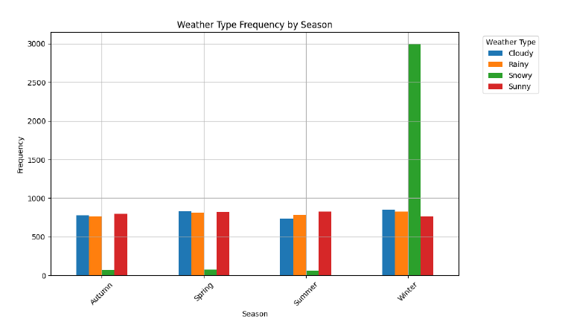
Most occurred weather
in particular season
Shows the most common weather conditions for each season (e.g., rainy in monsoon, clear in summer). This analysis helps in understanding seasonal weather patterns and predicting future conditions based on past data.

Slide 12
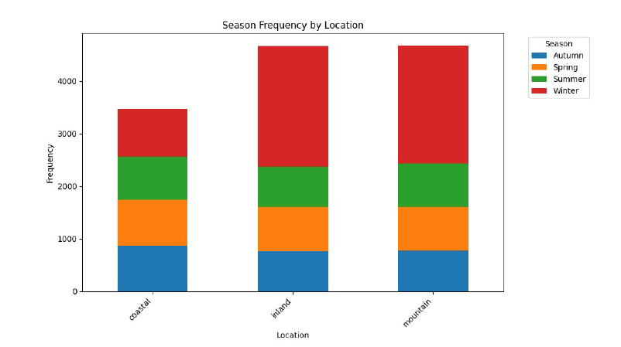
Location and season
Analyzes how weather varies across different locations in the dataset. This slide might highlight trends such as coastal areas being more humid or certain regions experiencing extreme temperatures compared to others.

Slide 13
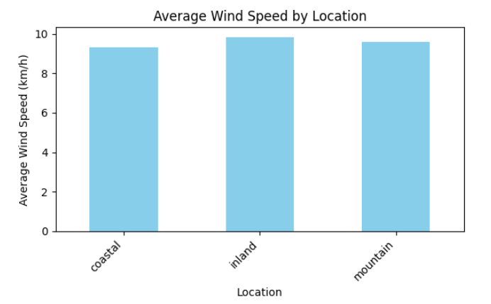
Average wind speed
Examines wind speed variations across seasons, identifying trends such as higher wind speeds during monsoon or lower speeds in stable weather conditions. This helps in understanding wind behavior over time.

Slide 14
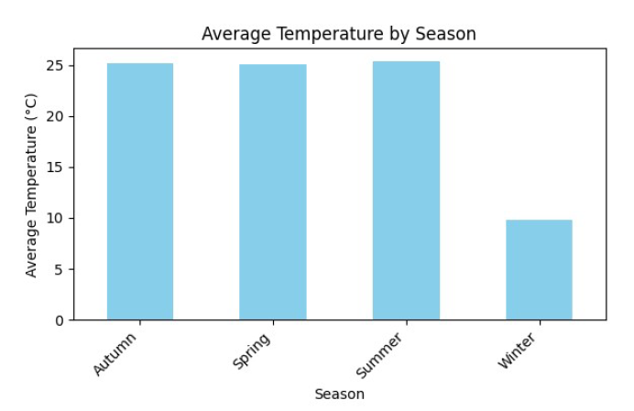
Average temperature
season wise
Displays the average temperature recorded for each season, making it easier to compare seasonal changes. The slide provides insights into how extreme or mild a particular season is based on past data.

Slide 15
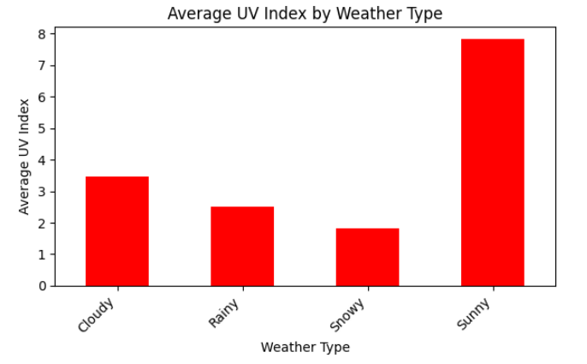
Average uv index
Analyzes the UV index across different seasons, showing when UV exposure is highest. This information can be useful for public health recommendations, such as advising higher sun protection in summer.

Slide 16
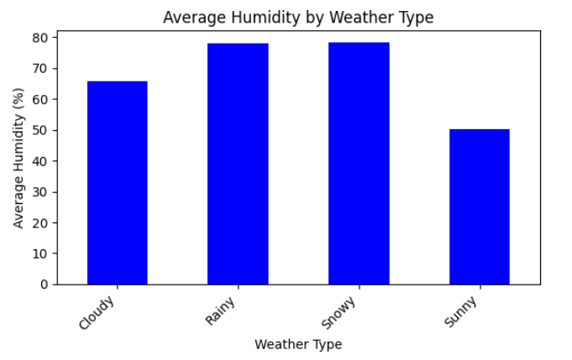
Average humidity
By season
Presents humidity levels across seasons, identifying trends such as high humidity in monsoon or lower humidity in winter. Understanding humidity variations helps in predicting weather comfort levels and potential rainfall.

Slide 17
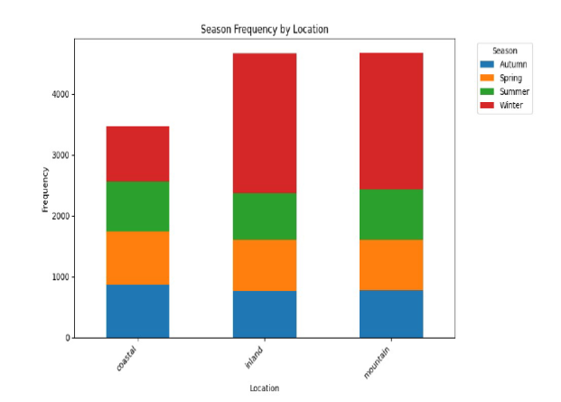
Thank you

